Slide 1
Funny, not Funny
Walter Squires | Kyungchan Lim | Autumn Henderson

Slide 2
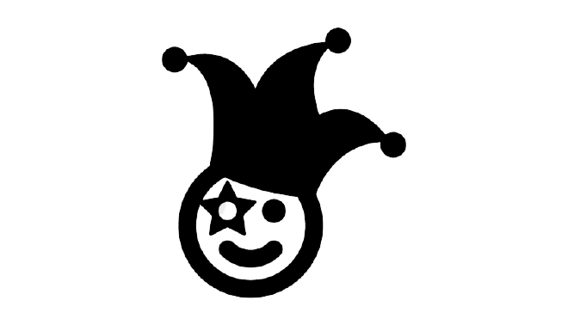
Introduction
Joke theft as old as jokes
19th century saw reliance on stock materials
1970s spike with popular comedians like Robin Williams
Can catch theft with ease today
Social Media
Recordings
Transcripts readily available
Determining originator still difficult
Copyright laws do not defend idea itself
Informal network-based institutions try to keep comedians in line
Notes:
If a known joke poacher came into the comedy club during the middle of your set, many comedians so end their set early rather than risk any of their experimental material be stolen
While comedy clubs are still relevant today, Stand-up is much more likely to be recorded in some form or fashion, and because of this, the acquisition of transcripts of a particular routine becomes much more available
Since comedians have had to take enforcement primarily into their own hands, often times joke poaching is met with violence

Slide 3
Objective
Establish a system that takes a joke by a comedian and determines whether comedian is originator.
Contributions
Baseline tool to detect joke theft
Data collection mechanism for comedian works
Motivating Questions
Can a tool be created that can determine originality with accuracy?
How prevalent is joke-poaching?
Who are the bad actors?
Notes:
Our main goal was to establish a system that takes a joke by a comedian and find out whether comedian is originator.
Our main contributions are
Develop a tool to detect joke theft
Data collection mechanism for comedian works
We came up with this goal because of some motivating questions
First question is, how accurately can we determine originality of jokes?
How widely spread is the joke-poaching?
Who are the bad actors in comedian world?

Slide 4
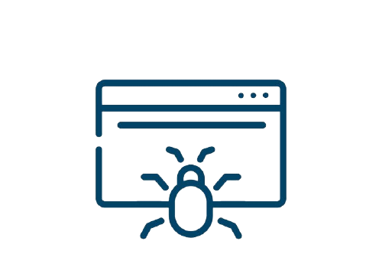
Methods
Gather Transcripts
Clean Data
Build Character Models
Test with Known Comedians
Notes:
With those goal in mind, we approach our goal by taking several steps.
First of all, Transcripts are acquired from ScrapesFromTheLofts.com; they are a site that collects and shares transcripts for many types of media, but in our case we are focusing on their collection of stand-up transcripts.
After scraping the site for transcripts all belonging to a particular comedian, the non-routine information is removed so that only the comedian’s words and the audiences reactions are present
When it comes to transcripts, they fall into two categories:
those that only contain the comedians words,
and those that contain any noise made during the routine;
for the purposes of this project, we focused primarily on the second type of transcript as they aided in the detection and classification of jokes. The first type of transcript could be used in our project with the slight modification by manually watching the routine and insert into the transcript indicators of audience laughter.
Cleaned transcripts are then analyzed to determine the presence jokes and these jokes are used to build a model for a given comedian. The model can then be given a joke, and it will return the probability of the given joke being written by that comedian.
The ultimate goal in this case is then to be able to build a model for a known comedian and identify jokes that are associated with them which might not actually belong to them.

Slide 5
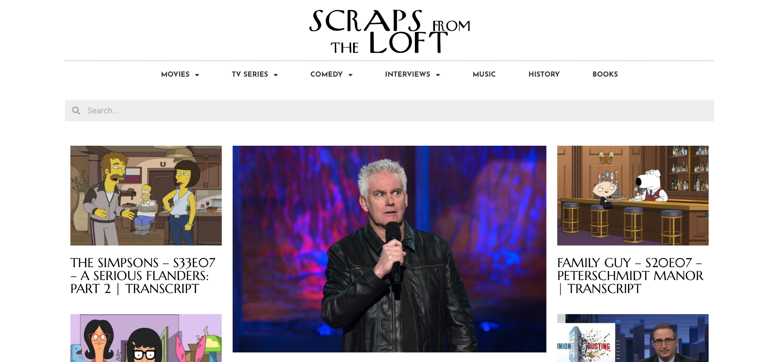
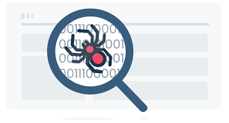
Scraping Site
Scraping source:
https://scrapsfromtheloft.com
Use request library in python to crawl basic text from the website
Use Beautiful Soup library to parse data from source we crawled
Clean up raw data into usable datasets
Notes:
Scraping source is ScrapeFromTheLoft.com
From the website, we used python code with request library to crawl raw dataset which is basic text form of joke script
Then we used Beautiful Soup library to parse raw data then get parts we want to analyze
Once we have crawled data, we cleaned up the raw data into usable datasets.
Next slides will explain what we did with our dataset.

Slide 6
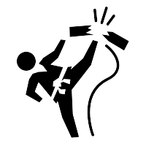
Breaking Up Routines
Notations of Laughter
Structure
Setup
Punchline
Tagline (Optional)
Assumption
Taglines related to joke with punchline
Area for improvement
Notes:
The routines we are using for building the models contain laughter or other noises made by the audience in the transcript. By combing through the transcripts by hand, we were able to identify which noises made by the audience can be used as indicators of a joke being present.
"audience laughing", "audience laughs", "Laughter and applause" these are all examples of indicator noises that are present in the transcript
The process for extracting the joke from the transcript operates under the assumption that jokes are made of 2 to 3 parts. The first two parts that all jokes have are the setup and the punchline. A third optional component is the tagline or taglines.
The setup consists of a number of uninterrupted lines of dialog from the comedian. When a joke indicator is identified, the program looks at the most recently spoken line of dialog. This is either a punchline, or a tagline. The punchline is identified as being the immediate payoff to the setup; if there has been dialog detected as setup, the line that provoked the laughter is considered a punchline. However, there are instances in which the comedian will say a line and illicit a response from the audience without setting up a joke. This is classified as a tagline, a payoff to a previously set up joke.
In our project, we take the naive approach that all taglines are related to the joke which most recently had a punchline; however, we recognize that this is not always the case and is a potential avenue on which the project can be further improved.

Slide 7
Building Character Models
Quantitative
Jokes are broken down
Measurements
Words in setup, punchline, tagline
Taglines present
Total word count of joke
Error Rates
Setup - 10%
Rest of joke - 45%
Qualitative
Checked for most common one-word phrases, then two-word phrases, etc.
Once phrase only appears once, words checked against other jokes by same comedian
Weighted scoring based on matches to longer phrases
Final value / number of words in joke
Values were calculated using leftmost percentage of jokes.
How do we improve methodology?
Notes:
One all of the jokes have been extracted, they can be fed into the character model. The character model currently looks at the collection of jokes both quantitatively and qualitatively.
On the quantitative side, each joke in the model’s collection is broken down into its component parts, and these are measured. Measurements of interest, are the number of words in the setup, number of words in the punchline, number of words in the taglines (if present), the number of tag lines a joke has (if any at all), and the total number of words in a joke. This was the first part of the model to be implemented, and even when testing a joke that was part of the dataset the model was made with, the percent error for any component of the joke was upwords of 45% with the exception of the setup component, which only had a 10% error rate.
The qualitative side focuses on the words and phrases contained in a joke. The most common one word phrases, as well as two-word phrases, three-word phrases, you get the idea, up to the point that a phrase only appears once in the collection of jokes, are used to see if a joke contains similar language to other jokes the comedian has told; for each word in the joke that is found in the top 15 of these categories, points are awarded, with matches to longer phrases being worth more points. This point value is then divided by the number of words in the joke to calculate the similarity score of the joke in question to the model.
In testing the accuracy of this model, we used a percentage of the extracted jokes for training, and a smaller percentage for checking the accuracy of the model. When using 95% of the jokes for training, the model was, on average, able to correctly identify the remaining 5% of the jokes 74% of the time. Using between 90% and 85% of the jokes for training resulted in average accuracy around the 70% mark, with accuracy dipping down to 62% accurate when only 80% of the jokes for training.
5% ~ 74.1538
10% ~70.5781
15% ~70.1567
20% ~ 62.-122
This is admittedly an area that may end up being left as “good enough”, as we try and complete the other milestones required for this project, but we would welcome any suggestions during our questions section with regards to what you think we could improve.

Slide 8
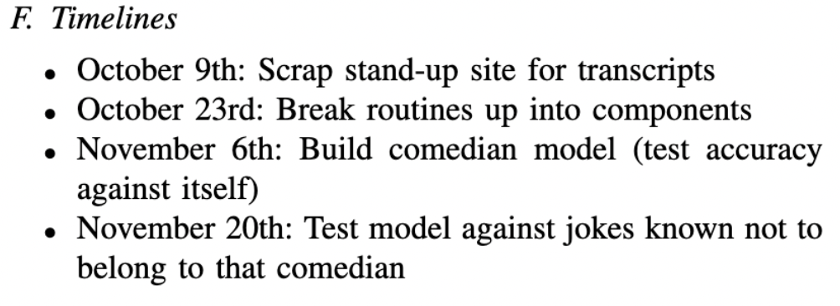
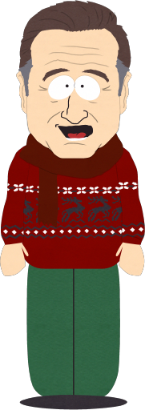
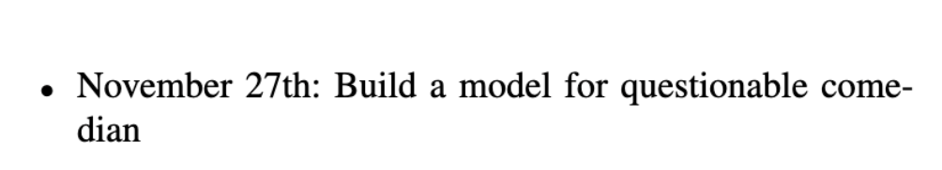
Testing Against Known Comedians
Notes:
The next step would be to test our model on jokes we know don’t belong to the modeled comedian to ensure that the model doesn’t report false positives. This hasn’t been completed yet.
Unfortunately, we’ve yet to be able to use the tool to test for any bad actor’s as we’re yet to finish the project!

Slide 9
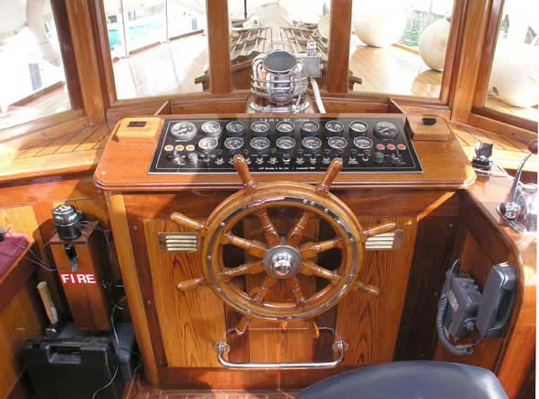
Roadblocks
Notes:
Pictured here, is a wheelhouse. Please note, WE are outside of it
This is outside of all of our wheel houses!
This project combines scraping the web for transcripts, cleaning data, identifying jokes and classifying their components, building models and training models, all of which is new material to everyone on this team.
Cleaning the data had hidden issues, such as irregular censorship depending on the transcript which needed to be manually identified and corrected
As I alluded to before, there are likely better ways to build the models that we are unaware of due to our unfamiliarity with this area.
That being said, I believe that as a group, we have done a great job of overcoming these hurdles, though there will likely be more to come.

Slide 10
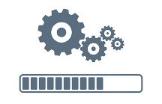
Status of Project
Accomplishments
Extract jokes from transcripts and classify their component parts
Build a model based off of these jokes and test it against jokes belonging to its own dataset
To-Dos
Test the model against jokes from different authors
Determine if the project will accurately determine joke poaching
Notes:
So far, we have been able to successfully scrape transcripts from a website, extract jokes from those transcripts, and classify their component parts as either setup, punchline, or tagline.
We have also been able to build a model based off of those jokes and test it against jokes that belonged to its own data set.
We still have a few tasks left to tidy up the rest of the project. We will want to test the model against jokes from different authors, which will require adding more transcripts to the database and cleaning those data sets. And we will ultimately need to determine whether the model will be able to determine joke poaching or what work will still need to be done to get the model to detect poaching at an acceptable rate.

Slide 11

Implications
Real-world
Identify unoriginal comedians
Prosecute joke theft
Future Research
Capture various types of transcripts
Create databases of originators and transcripts
Notes:
This project has a couple of major real-world applications. The first, and most obvious, is that it would be able to identify unoriginal comedians. Meaning reputations could be heavily affected. People could lose jobs or audiences and be black-listed from the comedy world. Or, maybe comedians will come clean or be honest about how they source their materials in hopes of retaining loyalty.
The second, more serious implication, is that if the model can be build with enough accuracy, it could potentially be used in legal settings. As of right now, there are no sure-fire ways to prosecute joke theft since copyright laws only protect the expression of an idea, not the idea itself, which is why many comedians get away with taking and modifying jokes. For written novels and other publications, there’s a steep price to pay for plagiarism. But jokes lack those legal ramifications.
There will be many ways to extend this project. One would be pulling many different types of transcripts. We stuck to ones that had clear structure and involved notation of laughter; adding other variations of transcripts will allow for wider use of the model. Likewise, if there are ways to include many types of transcripts or even pulling audio and transcribing it itself, then a much larger database of clean data of originators can be created.

Slide 12
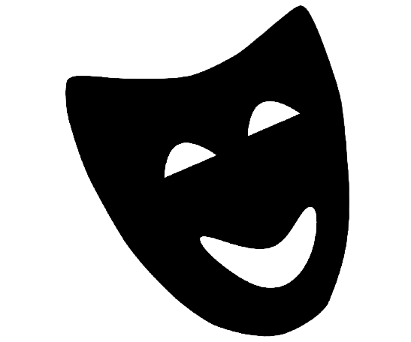
In Conclusion
Determining the originator of a joke is difficult
Comedians steal jokes regularly
Model compares transcripts for originality
Potential for use legally
Room to grow the program
Notes:
In conclusion, determining the originator of a joke is difficult for a variety of reasons, but largely because there is no real system to track this and there are no legal repercussions if one steals a joke. Joke theft happens regularly because of this, causing monetary loss to other comedians.
The model we are building aims to compare different transcripts from different comedians in order to test for originality, with the end goal of building a database and predicting originality with great accuracy.
The model, if developed properly, could potentially be used for legal proceedings. At a very low level, it can be used to blacklist bad actors.
We still have some work to do and there’s still opportunities for growth, but we are on the way to creating a great baseline for this concept.

Slide 13
Questions?

